Slide 1
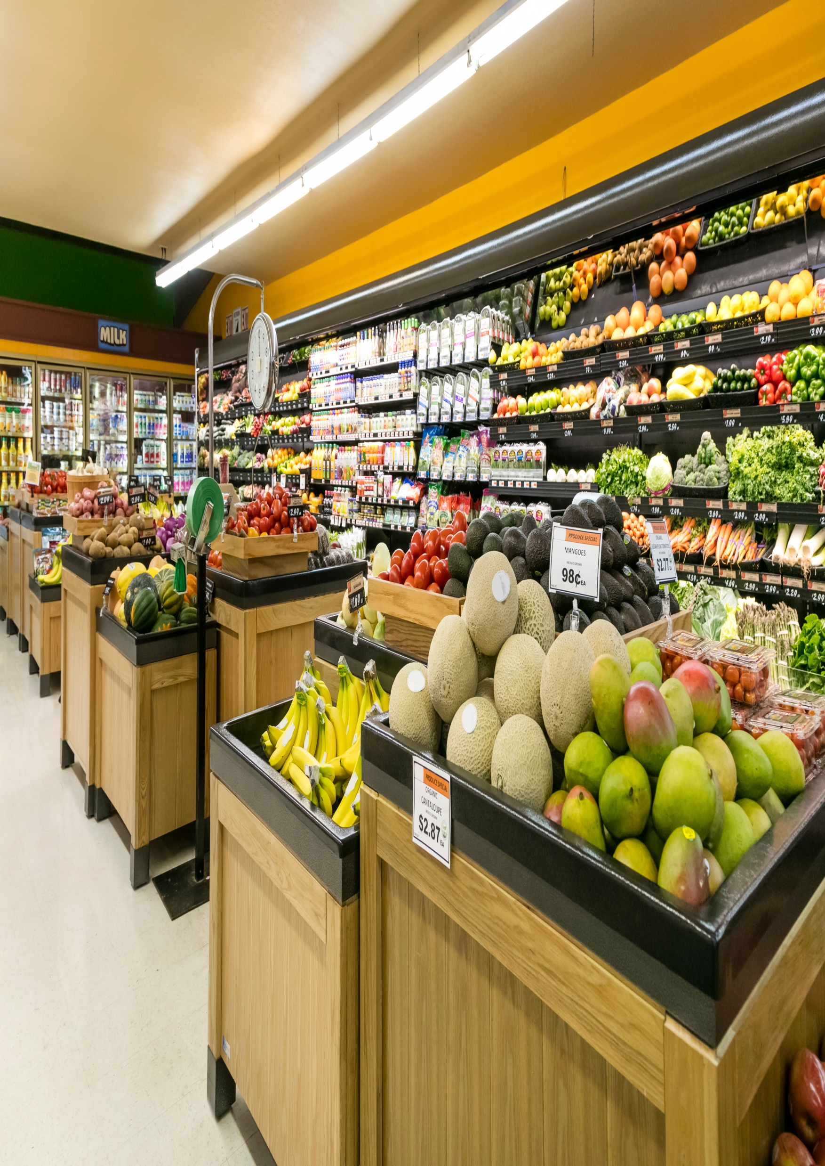

YOUR EVERYDAY FRESH MARKET
Walmart
DATA 415
Submitted to Professor Majid Amirfakhrian
Team Members: Chika Udeozor
Damian Ozobokeme

Slide 2


Walmart
WALMART STORE DATA ANALYSIS

Slide 3

Walmart
BUSINESS UNDERSTANDING
Using The Crisp-DM Methodology

Slide 4

Walmart
CASE STUDY
This case study aims to use historical Walmart weekly store sales gotten from Kaggle website and economic indicators to forecast future sales, comparison of sales during holiday and non-holiday periods for forecast, and also compare sales revenues between stores to adopt strategies in future.

Slide 5

INTRODUCTION
Walmart
Walmart is a large retail chain with multiple stores across the U.S and Canada with the dataset focusing on 45 U.S stores in different regions.
Each store records weekly sales and also contextual factors such as holiday weeks, temperature, fuel prices, CPI (Consumer Price Index), and unemployment.
Management needs accurate and actionable insights to forecast future sales in these stores, identify weeks with high-sales weeks in advance, and quantify the impact of holiday periods.

Slide 6

EXPLORING THE MESS
What business challenge is being faced by the business? | Business is facing challenges of unforseen demands for products thereby running out of stock from time to time.
Where is the gap between current and desired situation? | Business management currently rely on historical data to make business decisions without predictive insight. Desired state for the business is accurate forecasting of business sales. Therefore the gap is predictive analytics
What are the stated and unstated goals? | Stated goals include sales forecast, measuring holiday impact on sales, classifying weeks with high sales. Unstated goals include preventing inventory stockout, optimizing staffing especially during holiday seasons.

Slide 7

Walmart
SEARCHING FOR INFORMATION
What are the symptoms and causes? | Symptoms include unpredictable weekly sales, inventory stockouts, products overstocking, and inconsistent staffing levels. This is caused by lack of forecasting tools, sales seasonal variability, holiday effects on sales not being taken into consideration and analyzed
What measures of effectiveness seem appropriate? | Forecasting accuracy , improved operational processes,
What actions are available? | Forecasting tools such as Excel Forecasting and moving averages

Slide 8


Walmart
IDENTIFYING A PROBLEM
What is the most important problem in this situation? | Business is not able to predict weekly sales nor identify high demand weeks thereby resulting in poor planning and staffing.
Is this problem like others we have dealt with? | Yes- problem is similar to other retail businesses which do not use predictive analytics to support business decisions.
What are the consequences of a broad vs. narrow problem statement? | Broad statements (like improve sales performance) can lead to unclear objectives thus resulting in unfocused analysis whilst narrow problem statement is clear concise and focused on business challenge such as improving weekly and holiday sales using historical dataset

Slide 9
Walmart
SEARCHING FOR SOLUTION
What decisions are open to the business? | A combination of Excel’s Forecast.ETS for sales prediction, moving averages for smoothing. This provides accurate, insightful, and useful results.
what solutions have been tried in similar situations? | Other retail businesses commonly use these forecasting tools to aid in business decisions
How are the various solutions linked to the proposed business solution? | Future weekly sales are predicted using forecasting models (answering Q1). Future high-sales during holiday and non-holiday periods (answering Q2). Moving averages for store revenue comparison and future strategy adoption (answering Q3). To generate useful insights, each solution makes direct use of the Walmart dataset fields, such as weekly sales, holiday flags, and economic indicators.

Slide 10
Walmart
EVALUATING THE SOLUTION
How does this solution impact each of the criteria? | improved accuracy and increased ability in predicting weekly sales and high-sales weeks using forecasting; These improve planning, reduce stockouts, optimize staffing, and support data-driven decisions.
What factors within our control could improve the outcomes? | Clean dataset, choosing optimal K-Value,refined visualization for the forecasting.
What factors outside our control could alter the outcomes? | Changes in consumer behaviour, sudden unfavourable shift in economic situation, supply chain disruptions

Slide 11
Walmart
IMPLEMENTING THE SOLUTION
What are the barriers to successful implementation? | Limited expertise among staff for forecasting. inconsistent use of Excel tools by staff. There may be resistance to implementing data-driven decision-making, as well as a risk of misinterpreting predictive outputs during atypical market conditions.
Will there be support and motivation or resistance and conflict? | Support- Operations teams require more precise projections, and managers want to improve planning accuracy. Resistance- Teams might be hesitant to rely on predictive outputs and also employees used to manual or historical averages can also be a main source of resistance.
Are there resources available for successful implementation? | Yes- historical dataset, Excel forecasting tools

Slide 12
Walmart
DATA CLEANING

Slide 13

Walmart
The data types were checked to verify that they were correct by fixing date format- Short date, making sure the numeric columns have same number of decimal points.
For store and holiday flag columns, columns were checked to make sure no decimal point was present by using number format and choosing 0 decimal places.
Columns were checked for missing values by using filter list and checking for blanks at bottom of filter list.
Dataset was checked for duplicates using data function and remove duplicate option under data tools.
Numeric columns(weekly sales, Holiday Flag, fuel price, CPI) were also checked for negative values.

Slide 14
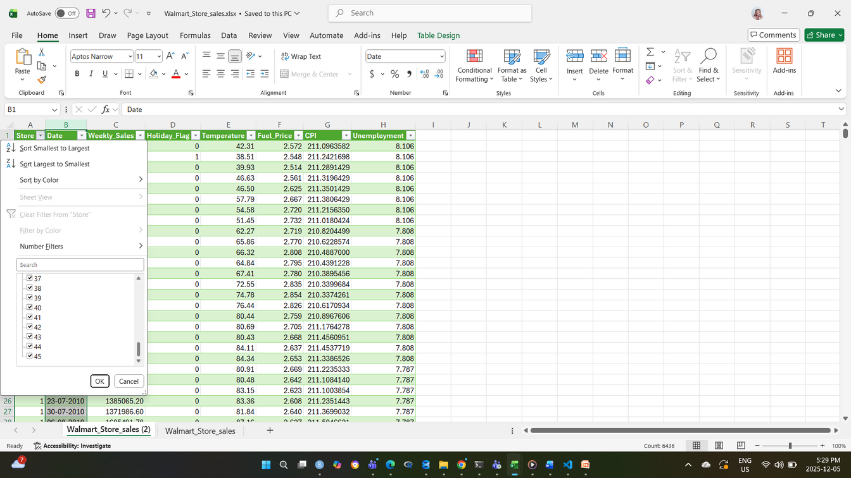
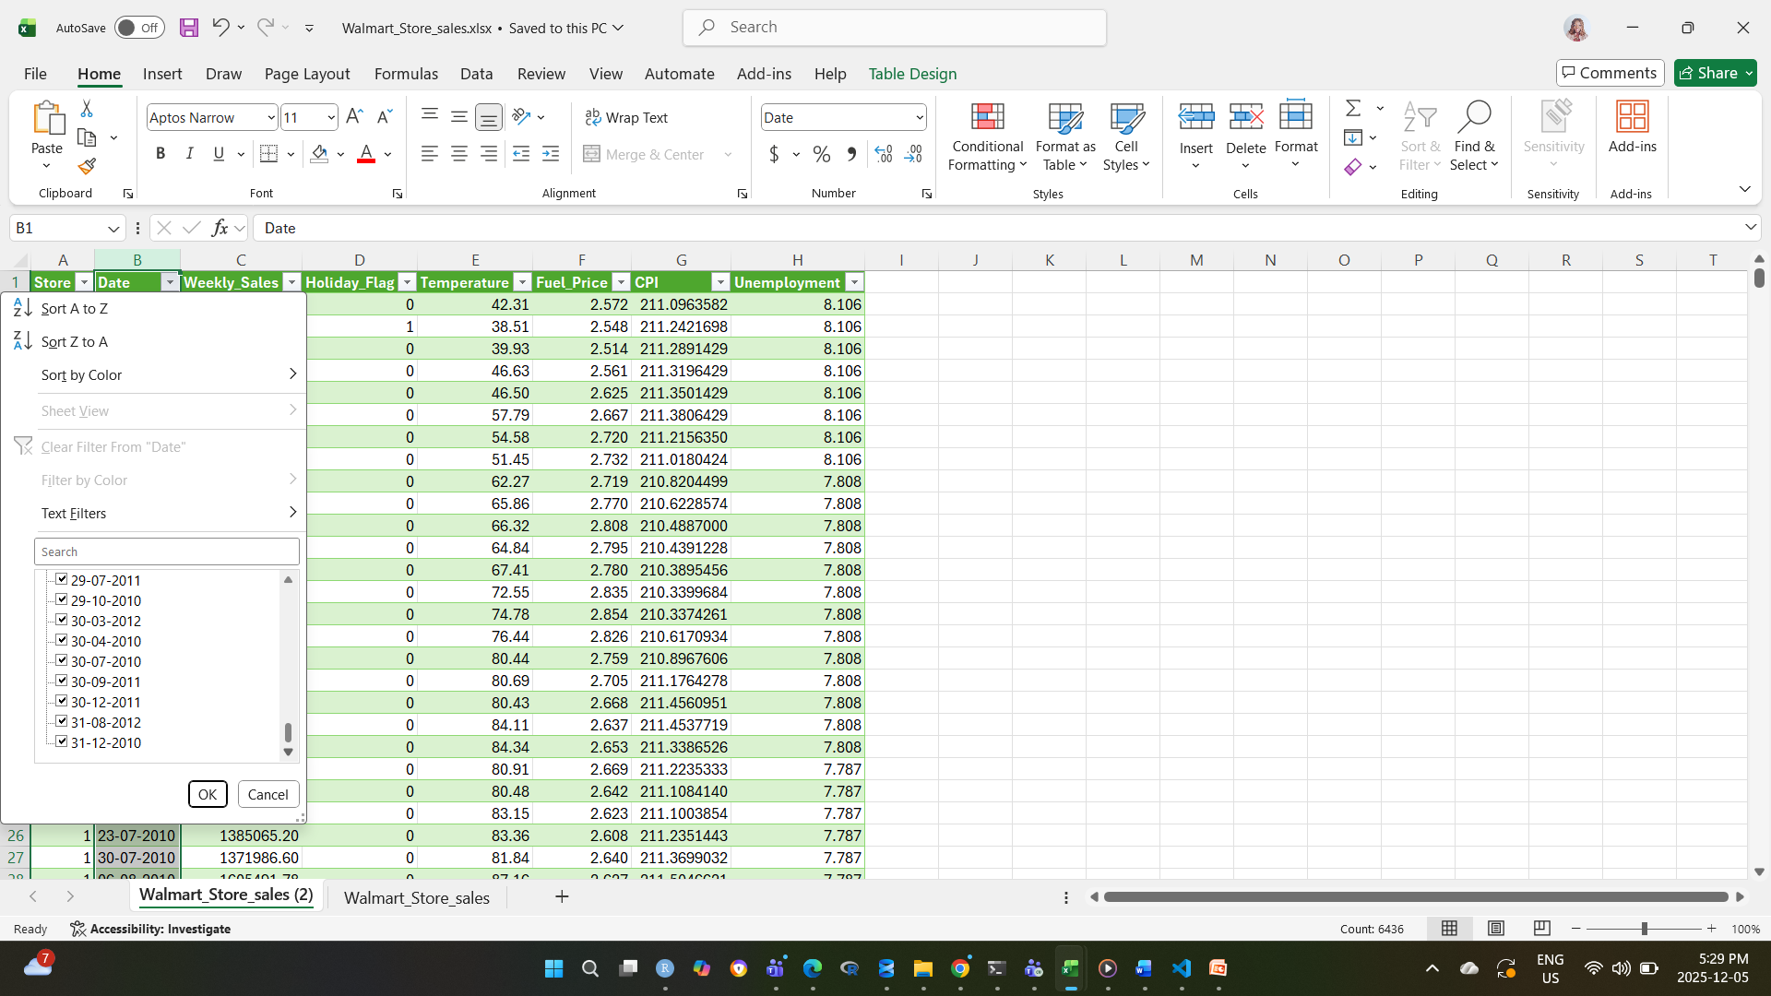
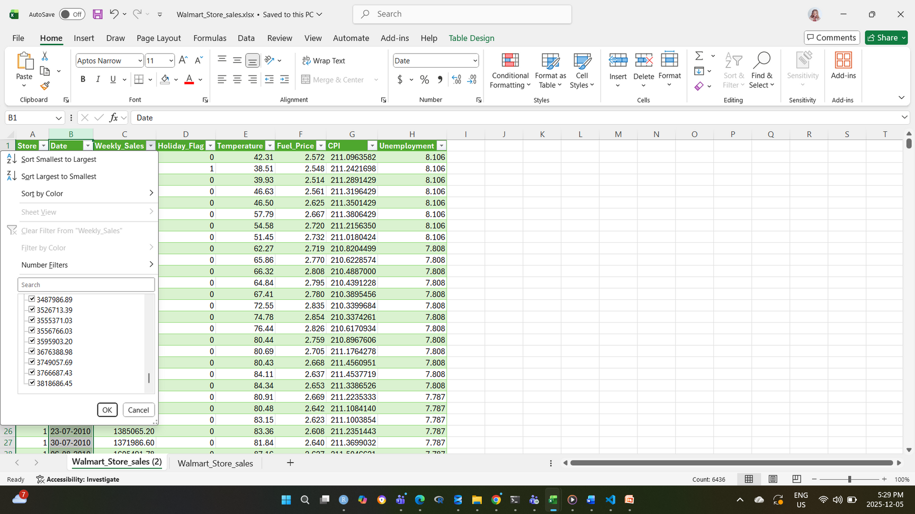
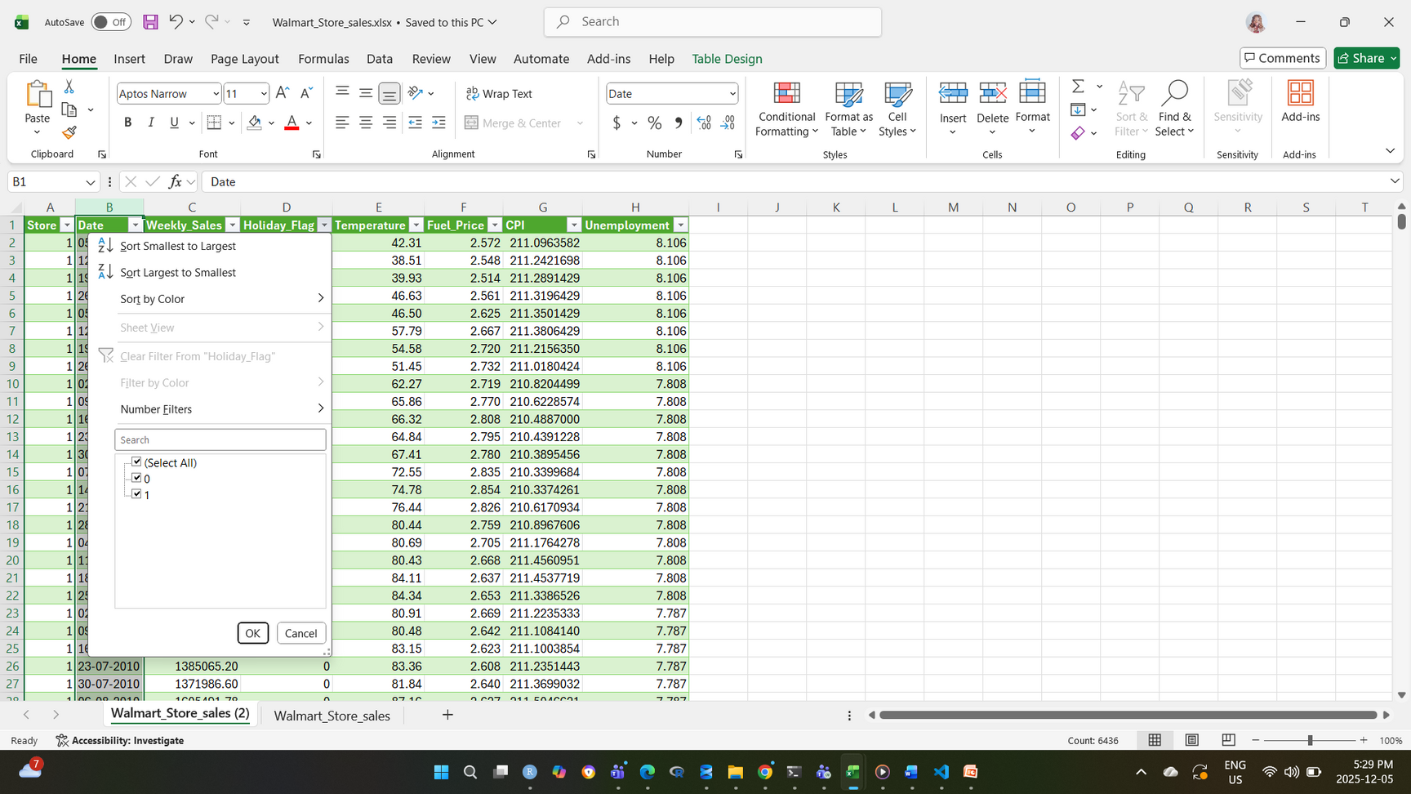

Slide 15
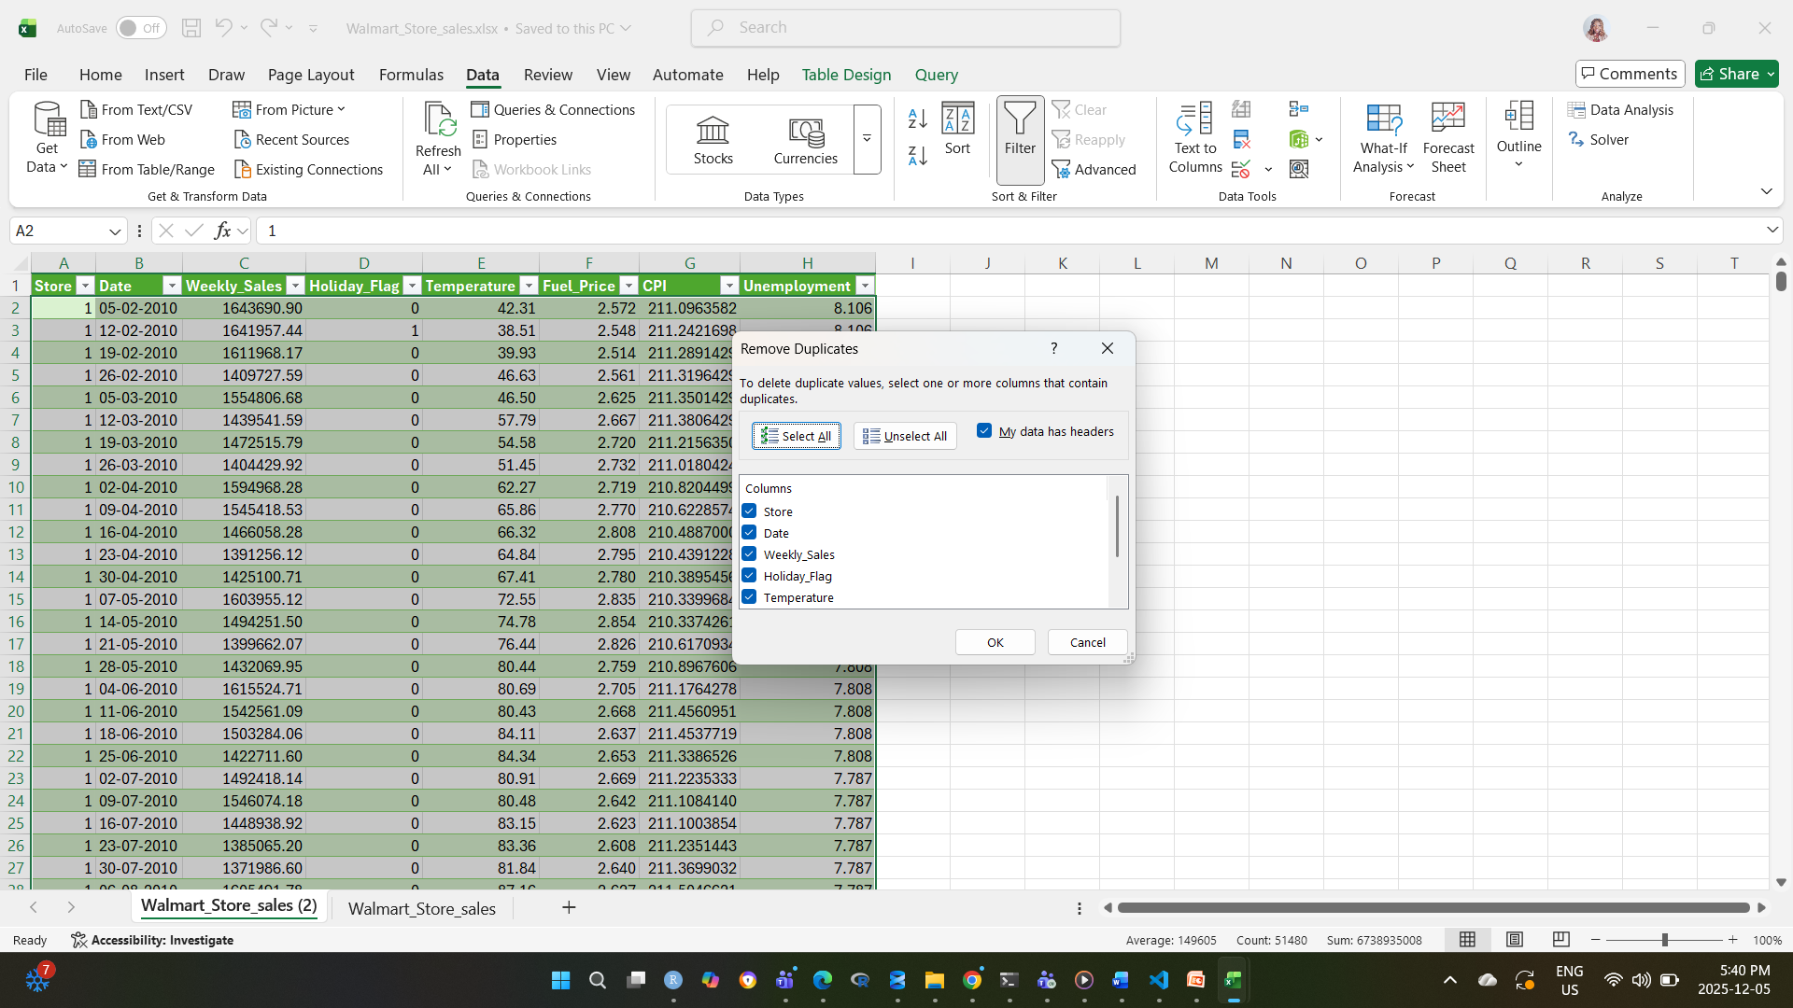

Slide 16
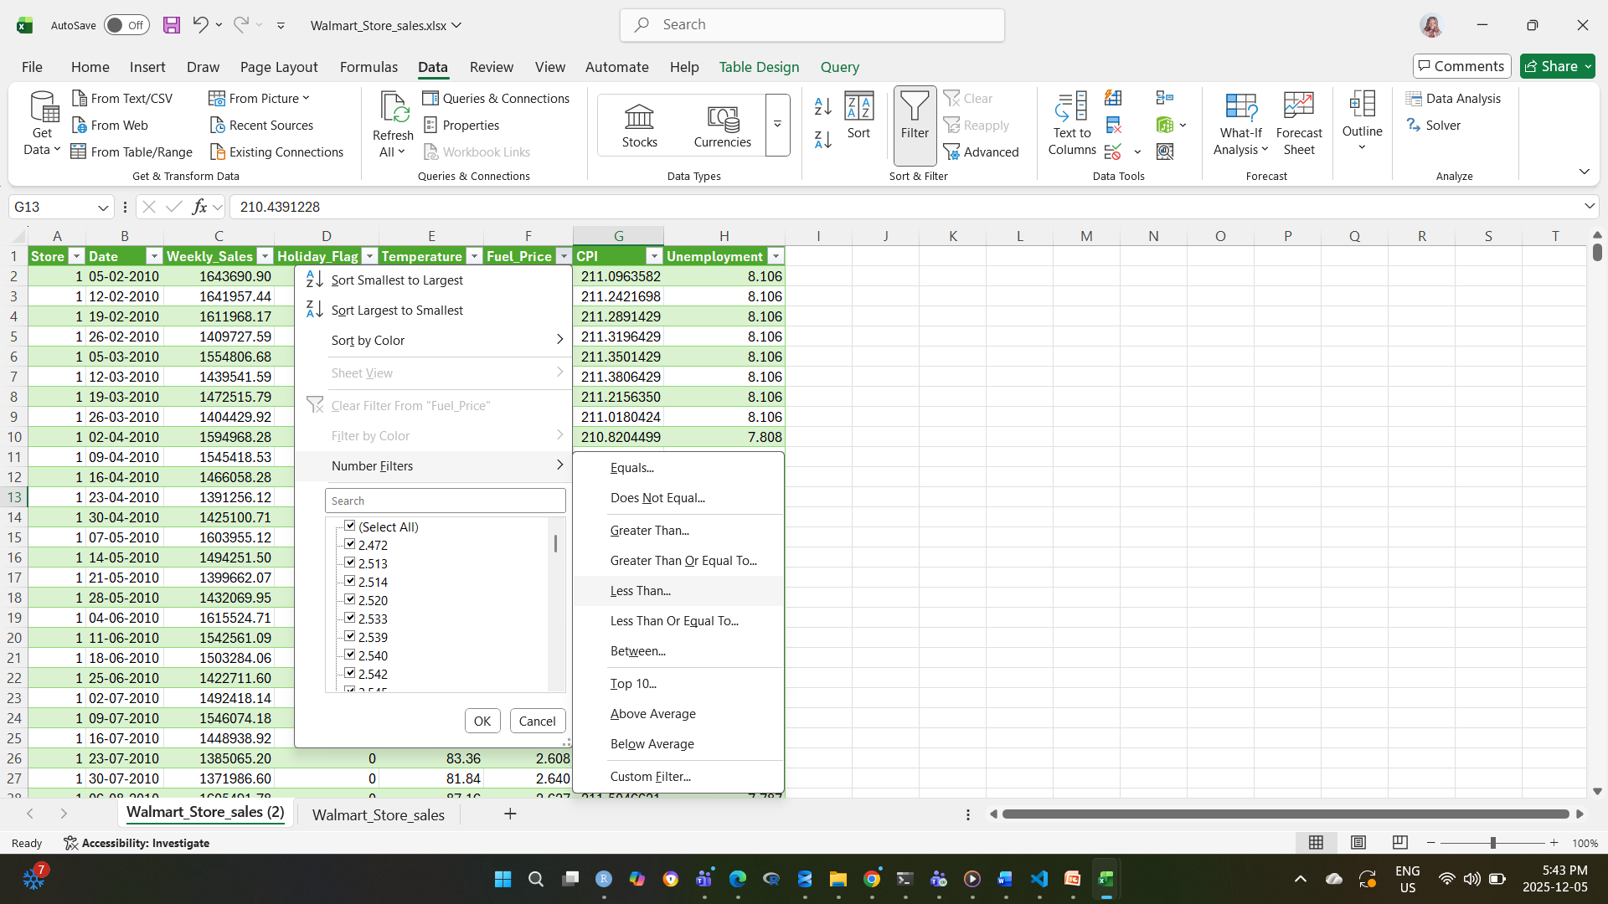

Slide 17
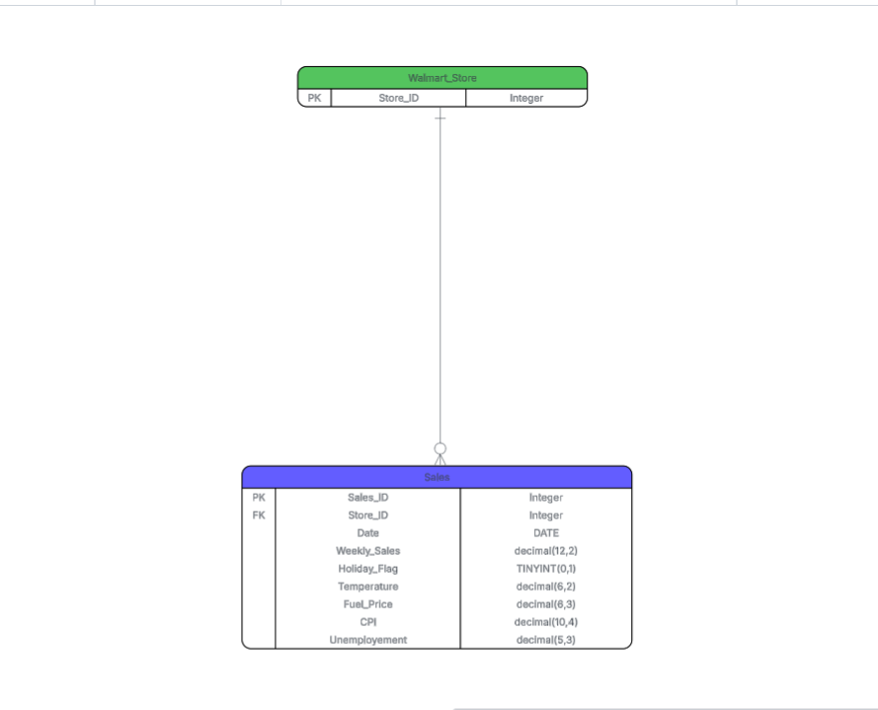
ERD Model

Slide 18
Data Dictionary
Field Name | Data Type | Description
Store | INT | Store Number
Date | DATE | Sales week
Weekly_Sales | DECIMAL(12,2) | Sales amount for a given store
Holiday_Flag | TINYINT(0,1) | Indicates whether the week is a holiday week or not.1- Holiday Week, 0- Non-holiday Week.
Temperature | DECIMAL(6,2) | Temperature for given day of sale
Fuel_Price | DECIMAL(6,3) | Fuel cost in region
CPI | DECIMAL(10,4) | Current consumer price index
Unemployement | DECIMAL(5,3) | Current unemployement rate

Slide 19
Walmart
BUSINESS QUESTIONS
QUESTION 1: “WHAT WILL THE AVERAGE WEEKLY SALES OF ALL WALMART STORES BE FOR THE NEXT 12 MONTHS?”

Slide 20
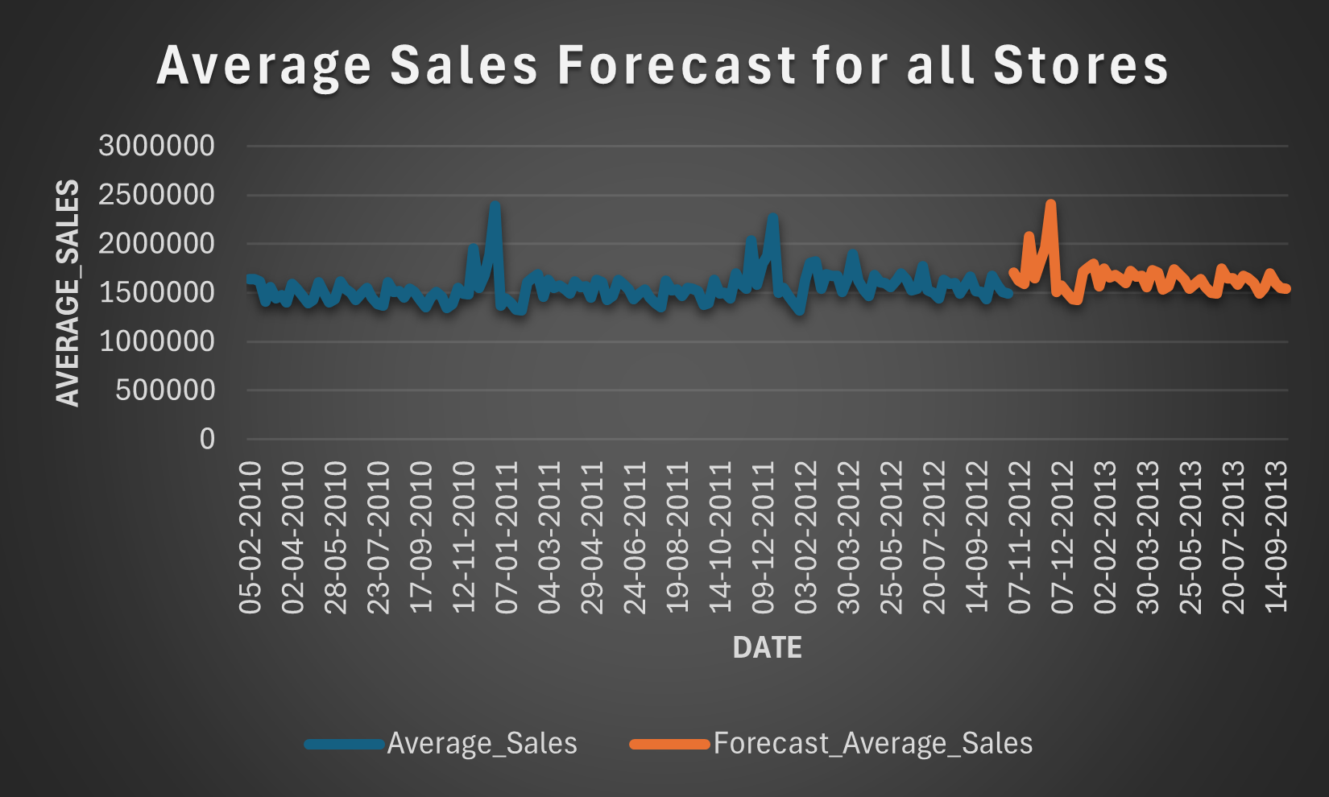
Walmart

Slide 21
Walmart
From the time series forecast, it is noted that the sales pattern for all the stores remain relatively stable with repetitive peaks during holiday periods and dips during non-holiday period.
There was absence of a clear upward and downward trend which suggests there is a consistency in the sales performance throughout the forecast period.

Slide 22
Walmart
BUSINESS QUESTIONS
QUESTION 2: “AT WALMART’S STORE 1, HOW WILL HOLIDAY WEEKS AFFECT WEEKLY SALES COMPARED TO NON-HOLIDAY WEEKS IN THE NEXT YEAR?”

Slide 23
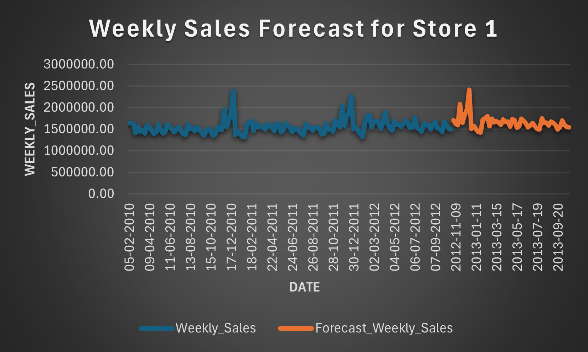
Walmart

Slide 24
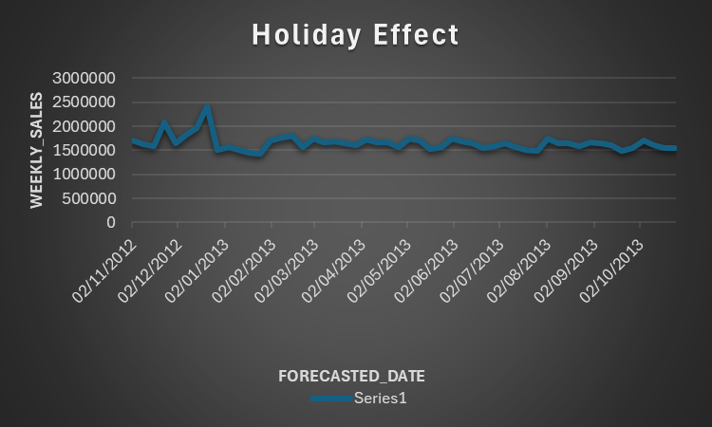
Walmart

Slide 25
Walmart
HOLIDAY TYPE | AVERAGE WEEKLY SALES
HOLIDAY | $1,122,887.892
NON-HOLIDAY | $1,041,256.38
DIFFERENCES(HOLIDAY VS NON-HOLIDAY) | $81,631.512
HOLIDAY SALES INCREASE(%) | 8%

Slide 26
Walmart
It can be observed from the time-series forcast and historical sales pattern for Walmart’s store 1, that the holiday weeks will generate a higher weekly sales of 8% as compared to non-holiday weeks in the next year.
This predicted increase is made because we observed that the total average sales registered during the holiday periods was consistent over the past years and it is expected to continue into future sales forecast assuming customers purchasing behavior remain the same.

Slide 27
Walmart
BUSINESS QUESTIONS
QUESTION 3: “HOW DO SALES TREND DIFFER BETWEEN STORE 1 AND STORE 2 AND HOW CAN THIS BE USED IN FUTURE PLANNING FOR SALES?”

Slide 28
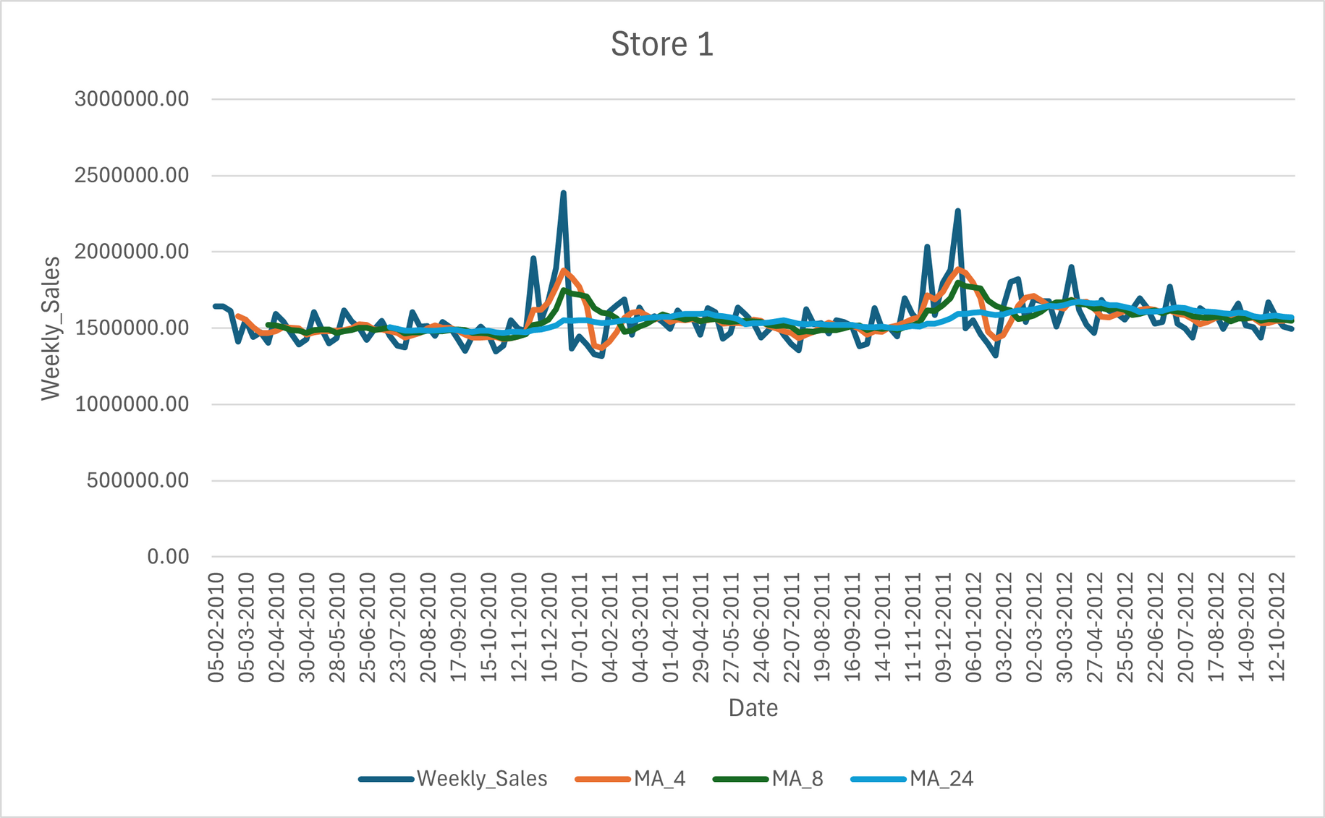
Walmart

Slide 29
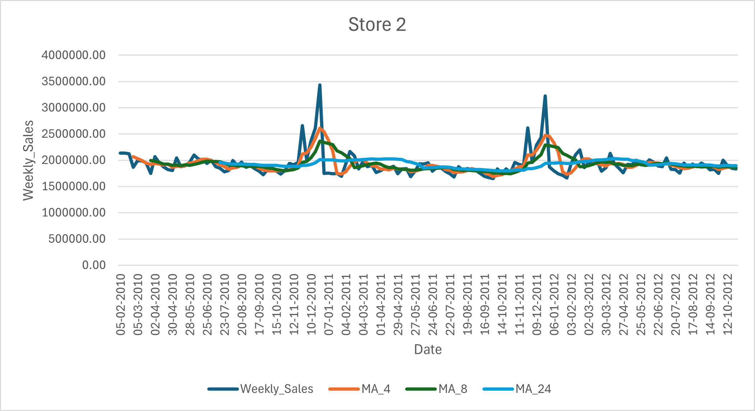
Walmart

Slide 30
Walmart
From the moving averages charts for Store 1 and Store 2, it can be seen that Store 2 outperforms Store 1 in weekly sales for all the periods.
Also the long-term (24 weeks MA) for store 2 shows declining weekly sales whilst Store 1 (24 weeks MA) is stable.
Both stores show consistent weekly seasonality, with strong sales spikes during major holiday periods (notably around late November and December).
Store 1 displays more volatility in weekly sales compared to Store 2, suggesting higher sensitivity to promotions, holidays, or local demand changes.

Slide 31
CONCLUSION
Walmart
The stores sales revenue can be increased by ensuring larger inventory volumes and more staffing around seasonal peaks (holidays) and to also reduce staffing cost (staff schedule adjustment) and reducing excess stock to minimize expenses and maximise profit during the non-holiday periods.
Since store 2 has a stronger and more predictable demand cycle; managers can confidently rely on 4- and 8-week moving averages for short-term planning.
It can also be suggested that Store 2 be used as a benchmark for staffing and inventory planning for store 1 due to better performance in comparison.
Also stricter forecasting methods is recommended for Store 1 management so as to reduce sales swings and make sure that the store is better stocked especially for peak periods.

Slide 32
References
OpenAI. (2025). ChatGPT (GPT-5.1) [Large language model].
Patel, R. (2022). Walmart dataset retail [Data set]. Kaggle.

Slide 33


Any Questions?

Slide 34


THANK YOU

